Slide 1
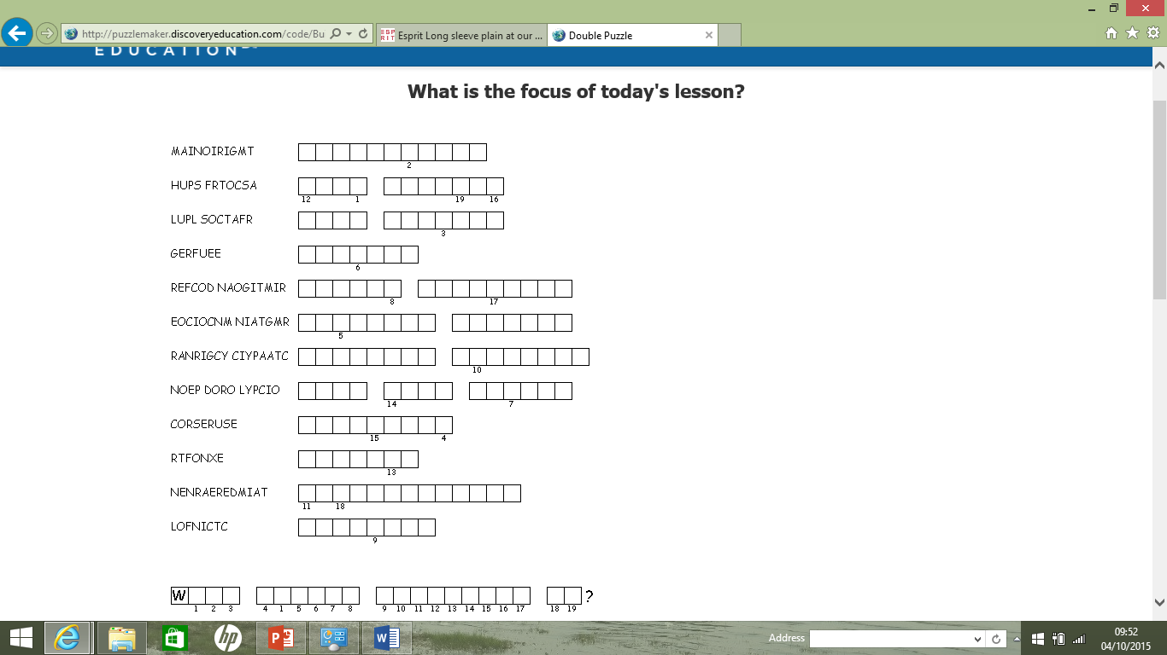
Double puzzle
You have been provided with a list of anagrams and definitions linked to our recent work on population and migration. Your challenge is to unravel the anagrams and to find out the title for today’s lesson. You can use your books if you need to but you only have 6 minutes to complete the task.
Finished? Write an additional fact or give an example for each of your answers
Start
End
Check your answers! In addition to the answers being revealed, you will also see a series of pictures. Using these pictures try to predict what you will be learning about in geography today.

Slide 2
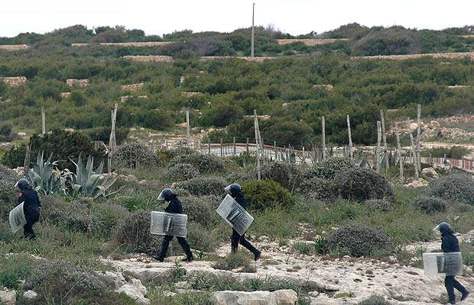

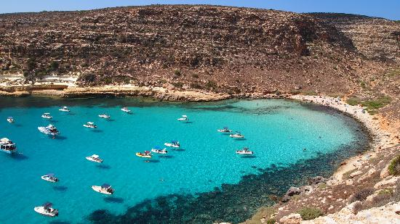
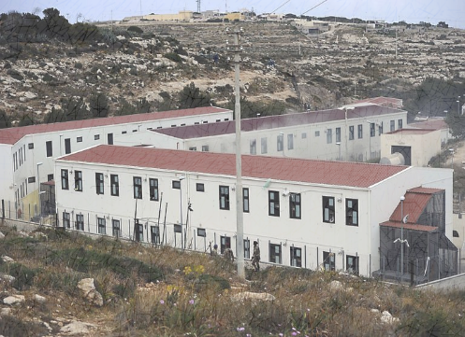
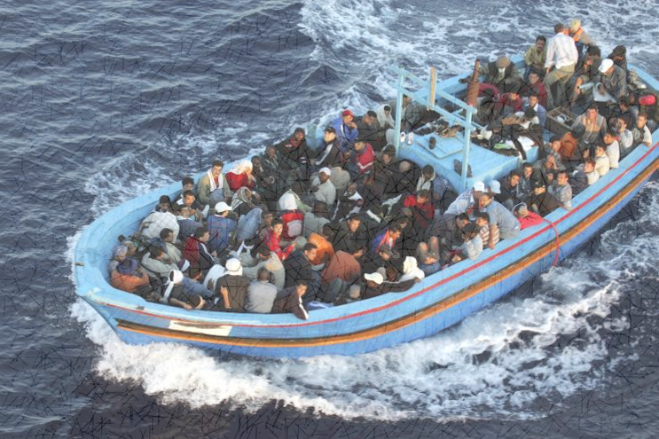

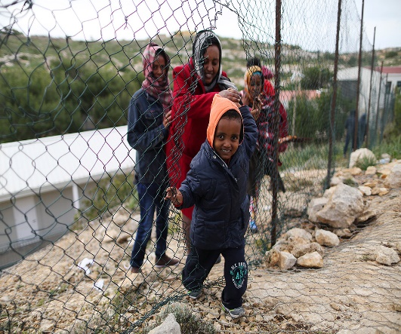
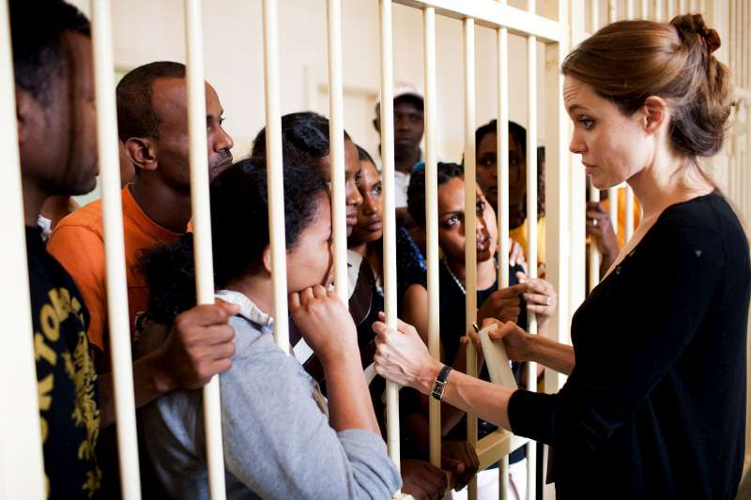
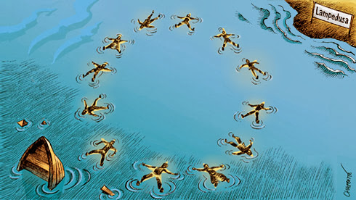
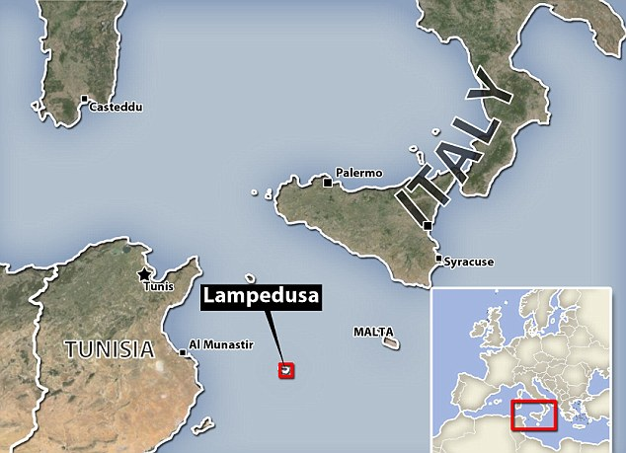
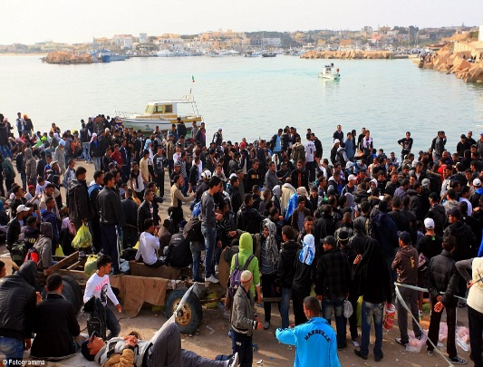
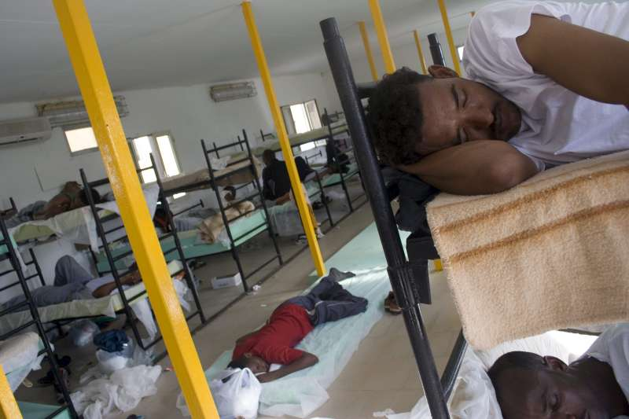
The name given to a migrant who has been forced to flee their country and needs a safe place to live.
The term used to describe the number of people which an environment can support.
The European border agency. This group are responsible for managing the borders in and out of Europe.
The process of people moving into a country.
Immigration
Carrying capacity
Refugee
Frontex
A negative factor that makes you want to leave an area.
When you have no choice but to leave an area.
When governments encourage immigration in order to support their country.
The name of the sea between North Africa and Europe.
Forced migration
Push factor
Open door policy
Mediterranean
The name given to a person that moves in order to get a better job or better wages.
These are what people make use of in order to survive. These can run out due to overpopulation.
A disagreement between two or more interest groups based on a difference of opinion.
A positive factor that makes you want to move to an area.
Economic migrant
Resources
Pull factor
Conflict

Slide 3
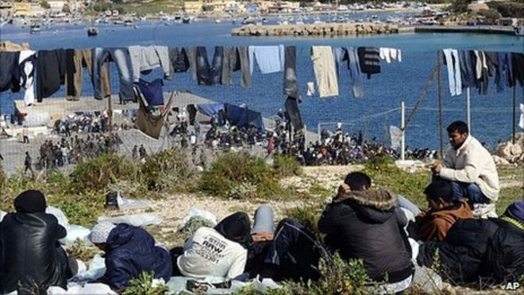
What should Lampedusa do?
During today’s lesson you will build up a case study linked to migration into an EU country.
By the end of the lesson you will have:
Revised key terms linked to migration
Used data to identify the push and pull factors causing migration.
Practiced an exam style question in preparation for your exam next week.
Identified the impacts of migration on an Italian island and the opinions of different interest groups.
Started to develop responses to help reduce the impacts of the migration crisis.

Slide 4
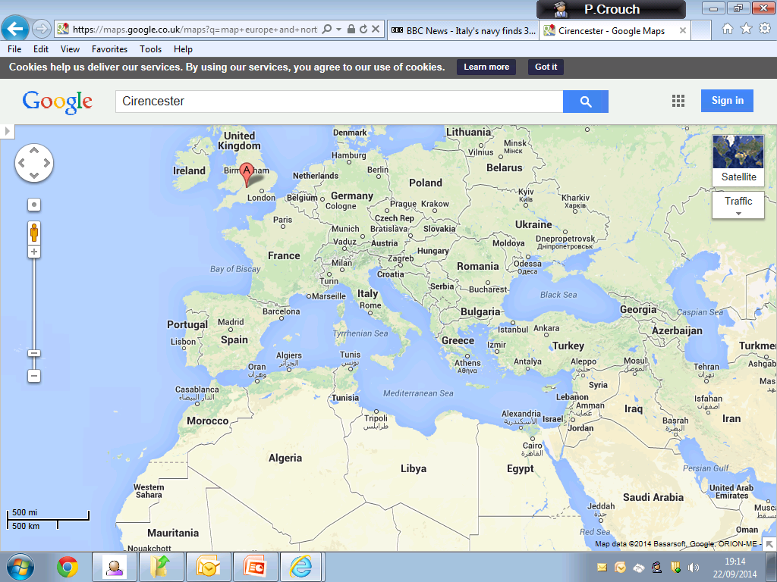
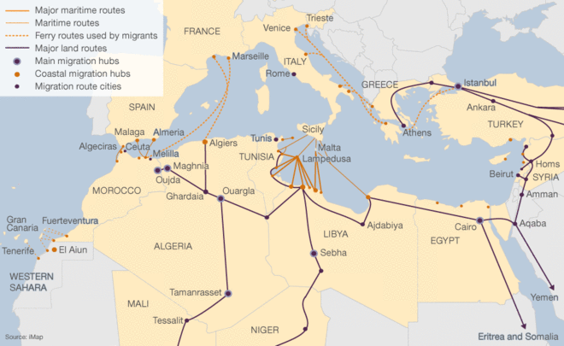
If you had to get from Syria to Northern Europe,
which way would you go?
Why are so many people arriving on the island of Lampedusa and where are they coming from?

Slide 5


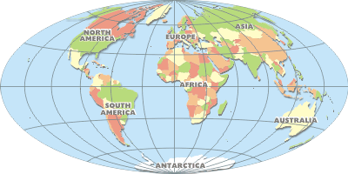


With reference to places you have studied and using the data provided, outline and explain the factors which are causing high levels of migration between developed and developing countries. 6 marks
Connectives

Slide 6
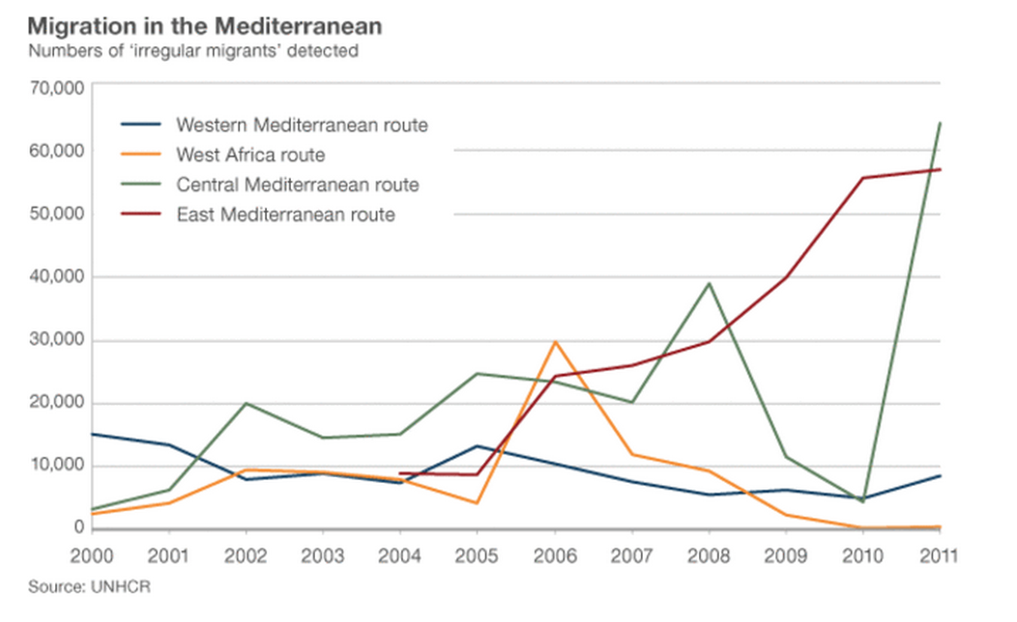
Why are so many people arriving on the island of Lampedusa and where are they coming from?
Push factors
Pull factors

Slide 7
Why are so many people arriving on the island of Lampedusa and where are they coming from?
Between which countries are you most likely to move as an economic migrant?
From which country are you most likely to flee as a refugee ?
In which country are you most likely to receive an old age pension?
In which country are you most likely to wait a long time to see a doctor?
In which country are you most likely to work on a farm?
 | Italy | Syria | Tunisia
Location in world | Europe | Asia | Africa
Political systems | Democracy | Civil war | Democracy
GDP per capita | 29,600 | 4,350 | 13,770
% working in agriculture | 9% | 33% | 28%
% of population aged over 60 | 21% | 3.9% | 8%
Female illiteracy rate | 1% | 23% | 29%
Doctors per 100,000 | 370 | 55 | 131
Human Development Index (the closer to 1 the higher the quality of life) | 0.854 | 0.589 | 0.683
Life expectancy | 82 | 68 | 74
Notes:
Most likely to

Slide 8
With reference to places you have studied and using the data provided, outline and explain the factors which are causing high levels of migration between developed and developing countries. 6 marks
Start
End
 | Italy | Syria | Tunisia
Location in world | Europe | Asia | Africa
Political systems | Democracy | Civil war | Democracy
GDP per capita | 29,600 | 4,350 | 13,770
% working in agriculture | 9% | 33% | 28%
% of population aged over 60 | 21% | 3.9% | 8%
Female illiteracy rate | 1% | 23% | 29%
Doctors per 100,000 | 370 | 55 | 131
Human Development Index (the closer to 1 the higher the quality of life) | 0.854 | 0.589 | 0.683
Life expectancy | 82 | 68 | 74
Connectives

Slide 9
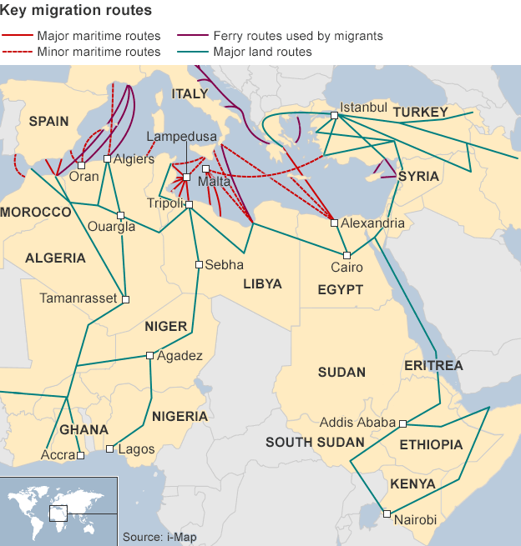

Level 1 1-2 marks E/D | Level 2 3-4 marks C/B | Level 3 5-6 marks A/A*
You describe how different countries could be effected by migration without using any data. (1) You use the data provided but do not use connectives to develop explanations and you list rather than expand. (1 ) You focus on developing one comparison between the Italy and Syria/Tunisia . (1 +1) GDP per capita is ……. In Italy but …….. in ……. this could mean that …….. Push factors would include …. Pull factors would include ….. | You clearly state the reasons for migration across the Mediterranean and you start to distinguish between economic and social reasons (1 +1 ) You use data in your answers to support points (1 +1) You focus on developing two comparison between the Italy and Syria/Tunisia . (2 x 2) | You use data to clearly identify the different push and pull factors which are causing migration across the Mediterranean. You distinguish between forced and economic migration. ( 1 + 1 x 3) There is evidence of additional/independent data be used to support your decision (1 +1) You use data consistently throughout your answer to support arguments. (1+1) You compare evidence of three indicators in Italy and Tunisia and Syria and use connectives to help develop the so what principle and explanations. (1+1 x 3)
Finished? Check your answer against the mark scheme and use the highlighter to show how your answer is great.
Connectives

Slide 10
Level 1 1-2 marks E/D | Level 2 3-4 marks C/B | Level 3 5-6 marks A/A*
You describe how different countries could be effected by migration without using any data. (1) You use the data provided but do not use connectives to develop explanations and you list rather than expand. (1 ) You focus on developing one comparison between the Italy and Syria/Tunisia . (1 +1) GDP per capita is ……. In Italy but …….. in ……. this could mean that …….. Push factors would include …. Pull factors would include ….. | You clearly state the reasons for migration across the Mediterranean and you start to distinguish between economic and social reasons (1 +1 ) You use data in your answers to support points (1 +1) You focus on developing two comparison between the Italy and Syria/Tunisia . (2 x 2) | You use data to clearly identify the different push and pull factors which are causing migration across the Mediterranean. You distinguish between forced and economic migration. ( 1 + 1 x 3) There is evidence of additional/independent data be used to support your decision (1 +1) You use data consistently throughout your answer to support arguments. (1+1) You compare evidence of three indicators in Italy and Tunisia and Syria and use connectives to help develop the so what principle and explanations. (1+1 x 3)
Last person standing!
Stand up and stay standing if the following statements apply to the answer that you have just written.
Connectives

Slide 11
What should Lampedusa do?
During today’s lesson you will build up a case study on migration into European countries.
By the end of the lesson you will have:
Revised key terms linked to migration
Used data to identify the push and pull factors causing migration.
Practiced an exam style question in preparation for your exam in two weeks time.
Identified the impacts of migration on an Italian island
Started to develop responses to help reduce the impacts of the migration crisis.

Slide 12
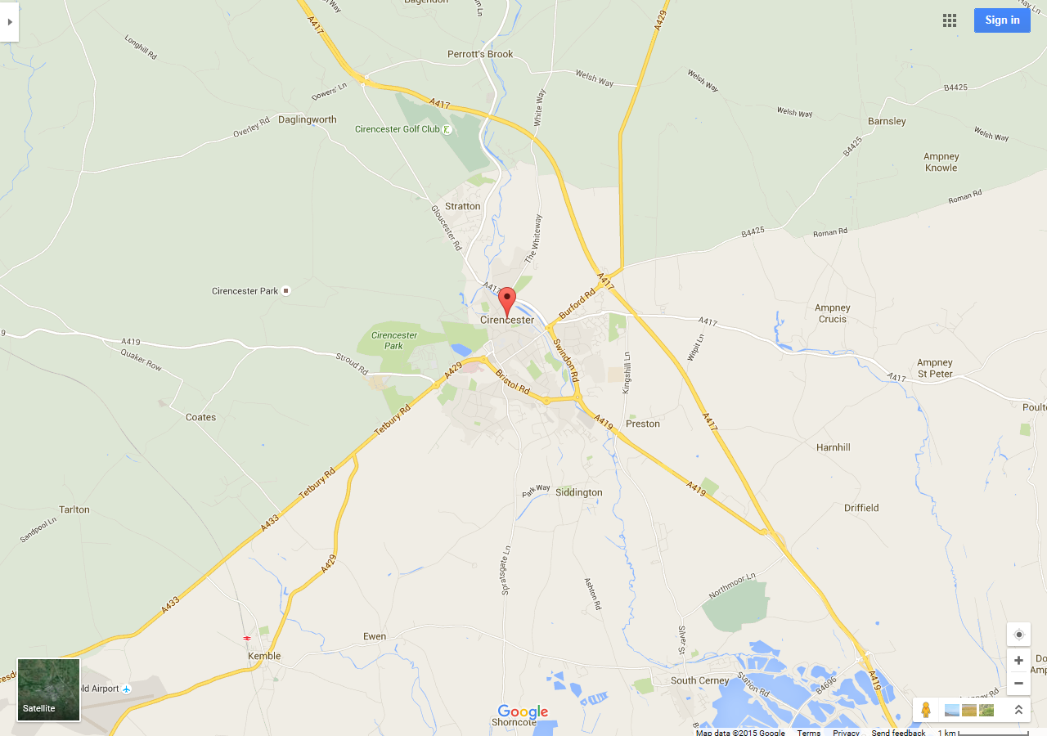
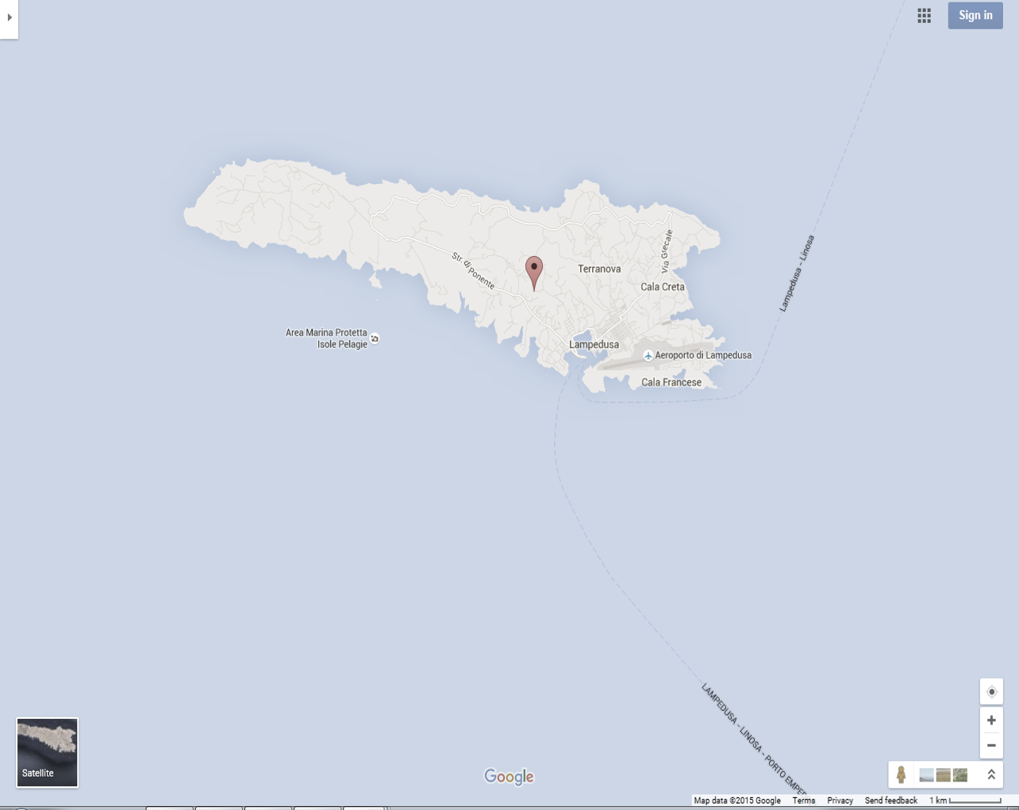
How big is Lampedusa?

Slide 13
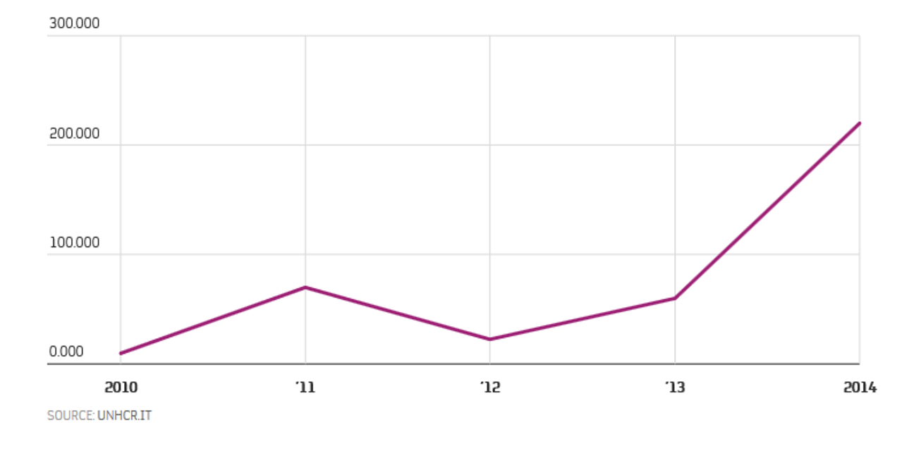
What impact could overpopulation have on the island of Lampedusa?
Impacts
Notes:
http://www.bbc.co.uk/news/world-europe-24486190 http://news.sky.com/story/1468979/migrant-boat-captain-faces-mass-murder-charges
http://www.liveleak.com/view?i=fc1_1429503291&comments=1

Slide 14
Who would have an opinion on the migration into Lampedusa?
Interest groups
Impacts
Notes:
http://www.bbc.co.uk/news/world-europe-24486190 http://news.sky.com/story/1468979/migrant-boat-captain-faces-mass-murder-charges
http://www.liveleak.com/view?i=fc1_1429503291&comments=1

Slide 15
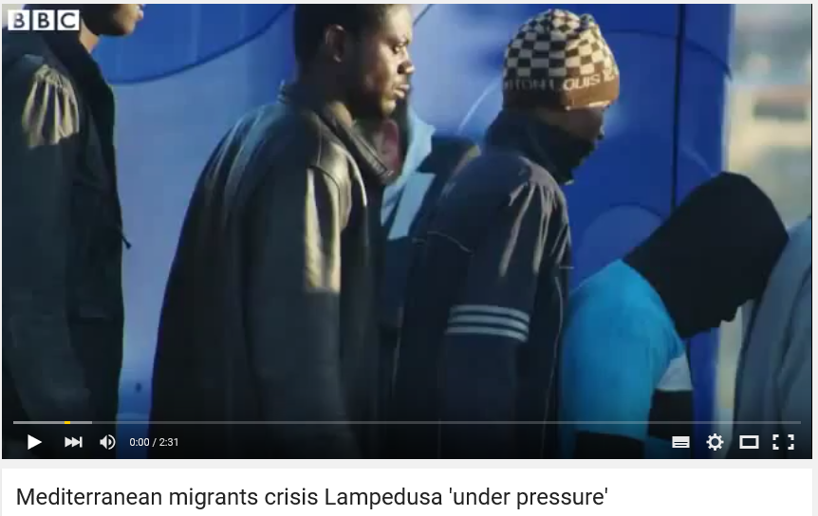
As you watch the video try to add at least one more impact of the migration into Lampedusa and one more interest group.

Slide 16
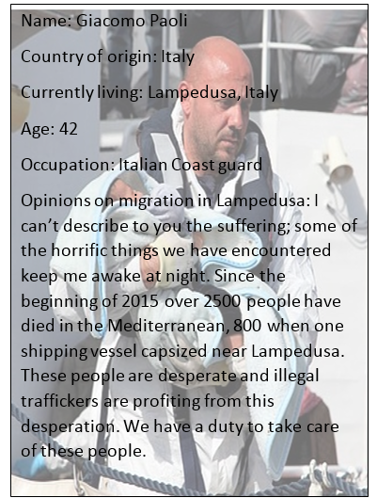

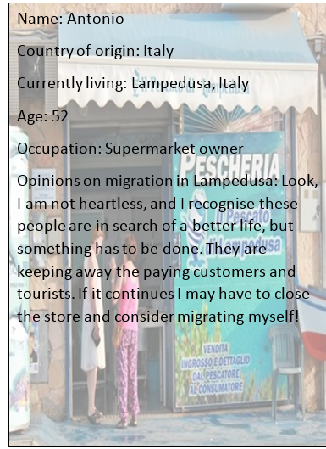

Conflict or cahoots?
Using the cards available find out about the different opinions that people have about migration into Lampedusa.
Place all the cards face down.
2. Pick a card each and read through the information.
3. Decide whether the two interest groups have different opinions (CONFLICT) or are in agreement on migration (CAHOOTS)
4. Add to your brainstorm by adding the interest group and a 5 word summary of their opinions.
Finished? Start to identify whether their impacts on migration are mainly social, economic, environmental or political. Also identify the problems which you think should be addressed first.

Slide 17

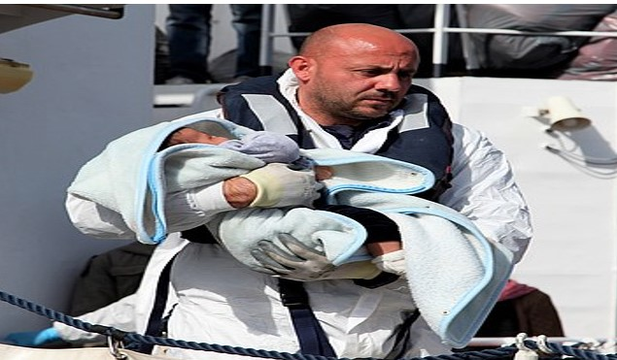

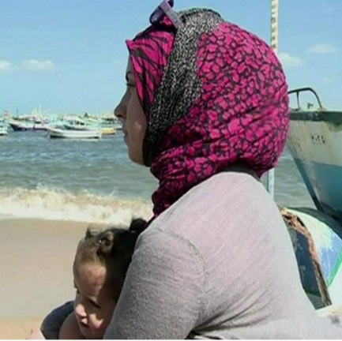

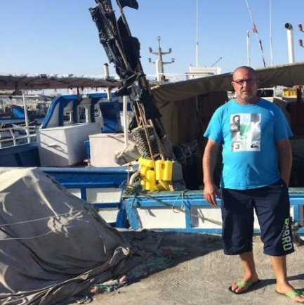

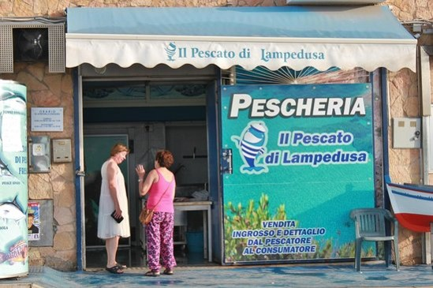
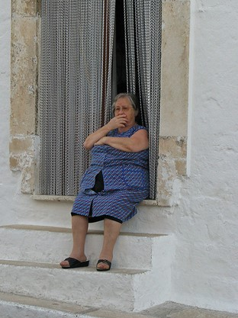


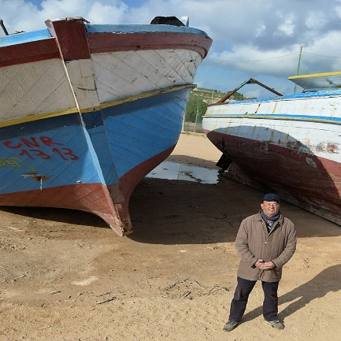

Slide 18
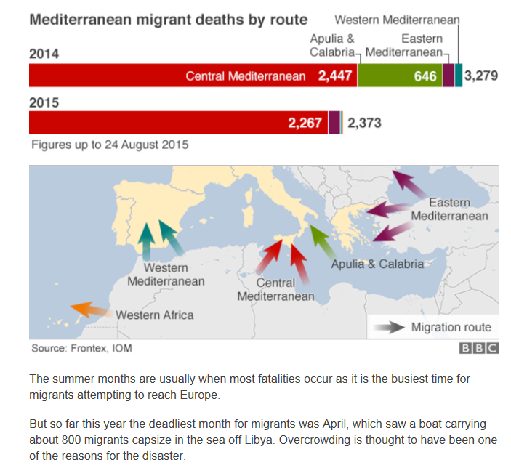

Slide 19
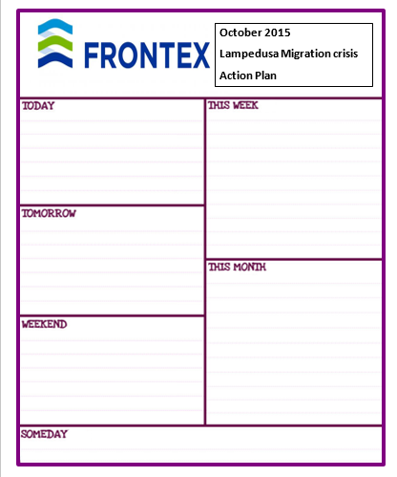
Your task, as the Chief of Frontex, is to start to put together an action plan to help deal with the crisis facing the island of Lampedusa and to support the increasing numbers of immigrants crossing the Mediterranean.
In your report you need to:
Consider the different viewpoints of the interest groups
Put forward short term actions to address the immediate problems in the host country
Develop long term actions to help deal with the push factors in the origin country.
I think that the first problem that should be solved in Lampedusa is …….because …... One solution to this problem would be ……………..

Slide 20
What should Lampedusa do?
During today’s lesson you will build up a case study on migration into European countries.
By the end of the lesson you will have:
Revised key terms linked to migration
Used data to identify the push and pull factors causing migration.
Practiced an exam style question in preparation for your exam in two weeks time.
Identified the impacts of migration on an Italian island
Started to develop responses to help reduce the impacts of the migration crisis.

Slide 21
